Slide 1

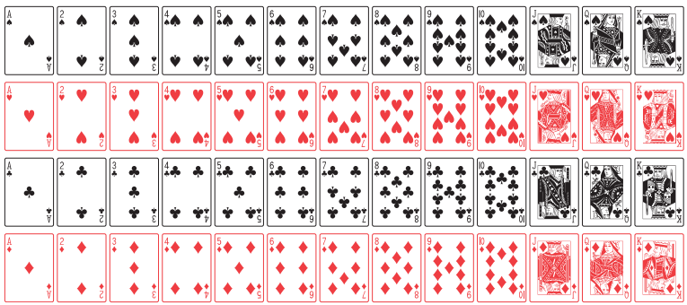
Introduction to Probability
Instructor
Osama Bin Ajaz

Slide 2
Content
Sample Space and Event
Tree diagram
Set theory
Venn diagram
Counting techniques
Additive and multiplicative rules for probability
Conditional probability
Bayes’ Theorem

Slide 3
Sample Space
What is an experiment?
Any process or activity that generates a set of data is called experiment. For example:
Tossing a coin
Rolling dice
Playing cards
Opinion of voters
Launching of missiles

Slide 4
Sample Space
The set of all possible outcomes of a statistical experiment is called the sample space (S). For example:
Notes:
Tossing a coin, Die rolling, sample point

Slide 5
Tree Diagram
Tossing coin: 2 times, 3 times, 4 times
Tossing die & coin together:
Suppose that three items are selected at random from a manufacturing process. Each item is inspected and classified defective, D, or non-defective, N. List the elements of the sample space.

Slide 6
Events
An event is a subset of a sample space. For example:
The complement of an event A with respect to S is the subset of all elements of S that are not in A. We denote the complement of A by the symbol A’.
Notes:
Rolling die and number less than 4 occurs.
Smokers, nonsmokers, light smoker, heavy smokers

Slide 7
Intersection of Events
The intersection of two events A and B, denoted by the symbol A ∩ B, is the event containing all elements that are common to A and B.
Let E be the event that a person selected at random in a classroom is majoring in engineering, and let F be the event that the person is female. Then E ∩ F is the event of all female engineering students in the classroom.
Let V = {a, e, i, o, u} and C = {l, r, s, t}; then it follows that V ∩ C = φ. That is, V and C have no elements in common and, therefore, cannot both simultaneously occur.

Slide 8
Mutually Exclusive events
Two events A and B are mutually exclusive, or disjoint, if A ∩ B = φ, that is, if A and B have no elements in common.

Slide 9
Union of events
The union of the two events A and B, denoted by the symbol A∪ B, is the event containing all the elements that belong to A or B or both.
Let A = {a, b, c} and B = {b, c, d, e}; then A ∪ B = ?
Let P be the event that an employee selected at random from an oil drilling company smokes cigarettes. Let Q be the event that the employee selected drinks alcoholic beverages. Then the event P ∪ Q =?

Slide 10
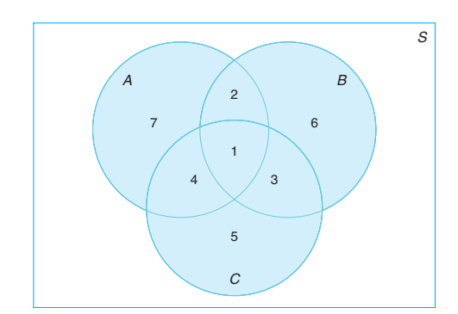
Venn Diagram
A ∩ B = B ∩ C = A ∪ C = B’ ∩ A = A ∩ B ∩ C = (A ∪ B) ∩ C’ =
1, 2
1, 3
1,2,3,4,5,7
4, 7
1
7,2,6,

Slide 11
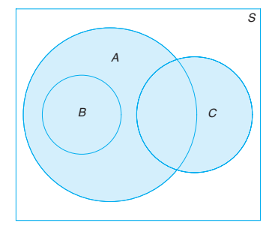
Venn Diagram
B ∩ C =
A ∪ B =
A ∩ C =
Null Set
A
At least one element

Slide 12
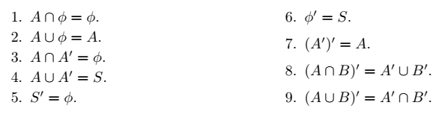
Venn Diagram
Several results that follow from the foregoing definitions, which may easily be verified by means of Venn diagrams, are as follows:

Slide 13
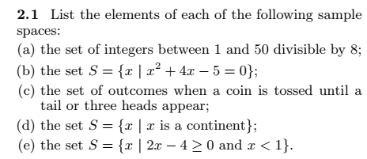
Notes:
(a) {8, 16, 24, 32, 40, 48} (b) (x+5)(x-1) = 0, S = {-5, 1} (C) {T, HT, HHH} (e) S = null set

Slide 14
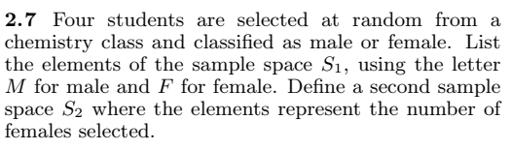
Notes:
S1 = { MMMM, …, FFFF} S2 = { 0, 1, 2, 3,4}

Slide 15
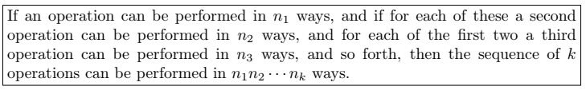
Multiplication Or Fundamental Rule of counting
How many sample points are there in the sample space when a pair of dice is thrown once?
How many there digit numbers can be formed from the digits 2, 4, 6, and 8 if: (i) repetitions are not allowed (ii) repetitions allowed
Notes:
(a) 36 (b) 24 & 64

Slide 16
Set of Example (iii - viii)
(iii) A developer of a new subdivision offers prospective home buyers a choice of Tudor, rustic, colonial, and traditional exterior styling in ranch, two-story, and split-level floor plans. In how many different ways can a buyer order one of these homes?
(iv) If a 22-member club needs to elect a chair and a treasurer, how many different ways can these two to be elected?
(v) Sam is going to assemble a computer by himself. He has the choice of chips from two brands, a hard drive from four, memory from three, and an accessory bundle from five local stores. How many different ways can Sam order the parts?
(vi) How many even four-digit numbers can be formed from the digits 0, 1, 2, 5, 6, and 9 if each digit can be used only once?
(vii) How many new arrangements can be made from the letters of the word FAVOUR so that vowel occupy even place.
Notes:
(iii) 12 ways (iv) 462 (v) 120 ways (vi) 156 (vii) 36

Slide 17
Permutation
A permutation is an arrangement of all or part of a set of objects.
The number of permutations of n objects is n!.
Suppose you have to arrange 3 books: Statistics, Maths, Physics on a shelf. How many arrangements are possible?

Slide 18

Permutations of “n” objects taken “r” at a time
In one year, three awards (research, teaching, and service) will be given to a class of 25 graduate students in a statistics department. If each student can receive at most one award, how many possible selections are there?
Notes:
25P3 = 13800

Slide 19
Example # 10:
A president and a treasurer are to be chosen from a student club consisting of 50 people. How many different choices of officers are possible if
(a) there are no restrictions;
(b) A will serve only if he is president;
(c) B and C will serve together or not at all;
(d) D and E will not serve together?
Notes:
(a) 50 x 49 = 2450 (b) 49 + 49P2 = 2401 (c) 2 + 48P2 = 2258 (e) 2450 – 2 = 2448

Slide 20

Circular Permutations
The number of permutations of n objects arrange in a circle is (n –1 )!.

Slide 21
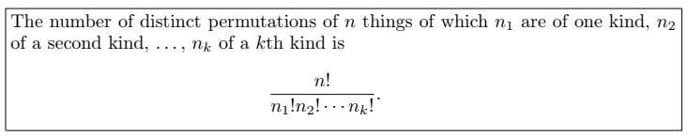
Permutations of n objects when they are not all different.
Find the number of permutations of 9995
In how many ways can the letters of the word STATISTICS be arranged?
In how many ways can 2 red, 3 blue, and 4 green chips be arranged in a row, if the chips of same color are not distinguishable from each other?
Notes:
(i) 4 (ii) 50,400 (iii) 1260

Slide 22
In a college football training session, the defensive coordinator needs to have 10 players standing in a row. Among these 10 players, there are 1 freshman, 2 sophomores, 4 juniors, and 3 seniors. How many different ways can they be arranged in a row if only their class level will be distinguished?
Notes:
12600

Slide 23

Combinations
Selection of “r” objects from “n” different objects and when the order is not important.
In how many ways a committee of 3 students can be selected from 4 students.
From a group of 10 boys and 6 girls a committee of 3 boys and 2 girls are to be selected. In how many ways can this done?
Notes:
4C3=4 (b) 120 x 15 = 1800 ways

Slide 24
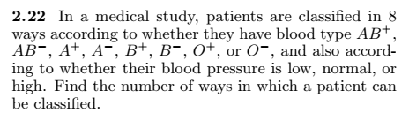
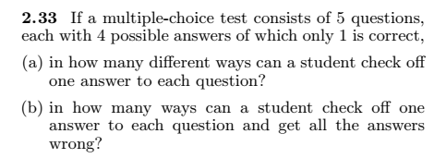

Exercises
Notes:
(2.22) 8*3 = 24 (2.33) (a) 4^5=1024 ways (b) 3^5=243 ways (2.37) 5*4*4*3*3*2*2*1*1= 2880

Slide 25



o
Notes:
(2.45) 3360 (2.47) 8C3=56 ways (2.48) 365P60 = l=3.2e151

Slide 26
Probability
Probability is a measure of the chance that
an uncertain event will occur.
Subjective:
Personal experiences
Objective:
Classical approach
Relative frequency approach
Axiomatic approach

Slide 27
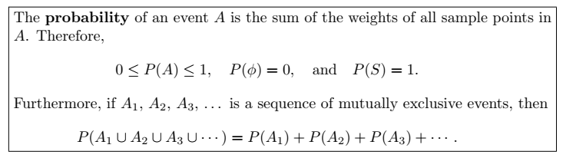

Slide 28
Examples (1 – 3)
A coin is tossed twice. What is the probability that at least 1 head occurs?
A die is tossed once. What is the probability of getting:
(a) an even number (b) a number less than 3 (c) a 4 or higher number (d) a 7 (e) A number from 1 to 6
3. A die is loaded in such a way that an even number is twice as likely to occur as an odd number. If E is the event that a number less than 4 occurs on a single toss of the die, find P(E).

Slide 29
Example 4
Two balanced dice are rolled once. What is the probability of getting
(a) A sum of 11 (b) same number on both dice (c) a sum of 13

Slide 30
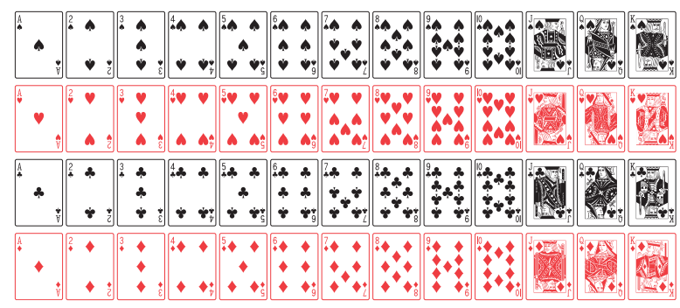
A deck of playing Cards

Slide 31
Example 5 – 6
5. A card is drawn at random from the well shuffled pack of 52 playing cards. Find the probability that the card:
(a) is a Jack (b) is not a Jack
6. In a poker hand consisting of 5 cards, find the probability of holding 2 aces and 3 jacks.
Notes:
(a) 4/52= (b) 12/13 (6) 24/2598960 = 0.00009

Slide 32
Example 7
A statistics class for engineers consists of 25 industrial, 10 mechanical, 10 electrical, and 8 civil engineering students. If a person is randomly selected by the instructor to answer a question, find the probability that the student chosen is (a) an industrial engineering major and (b) a civil engineering or an electrical engineering major.
Notes:
(a) 25/53 (b) 18/53

Slide 33

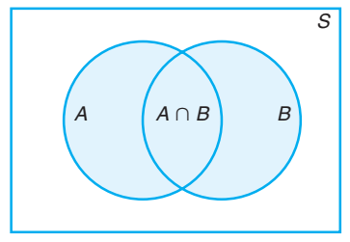
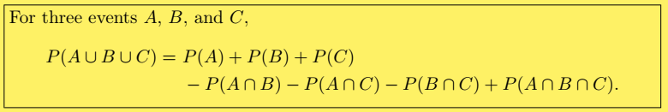
Additive Rule: Not - Mutually Exclusive Events

Slide 34
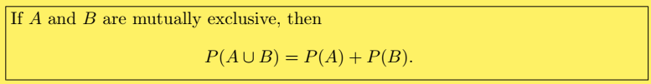
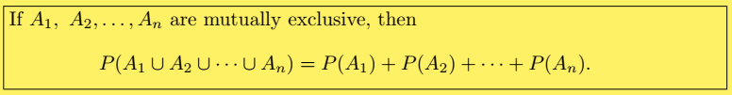
Additive Rule: Mutually Exclusive Events

Slide 35
Example # 08 – 10
8. John is going to graduate from an industrial engineering department in a university by the end of the semester. After being interviewed at two companies he likes, he assesses that his probability of getting an offer from company A is 0.8, and his probability of getting an offer from company B is 0.6. If he believes that the probability that he will get offers from both companies is 0.5, what is the probability that he will get at least one offer from these two companies?
What is the probability of getting a total of 7 or 11 when a pair of fair dice is tossed?
If the probabilities are, respectively, 0.09, 0.15, 0.21, and 0.23 that a person purchasing a new automobile will choose the color green, white, red, or blue, what is the probability that a given buyer will purchase a new automobile that comes in one of those colors?
Notes:
(8) 0.9 (9) = 2/9 (10) 0.68

Slide 36
Examples (11 – 12)
If the probabilities that an automobile mechanic will service 3, 4, 5, 6, 7, or 8 or more cars on any given workday are, respectively, 0.12, 0.19, 0.28, 0.24, 0.10, and 0.07, what is the probability that he will service at least 5 cars on his next day at work?
Suppose the manufacturer’s specifications for the length of a certain type of computer cable are 2000 ± 10 millimeters. In this industry, it is known that small cable is just as likely to be defective (not meeting specifications) as large cable. That is, the probability of randomly producing a cable with length exceeding 2010 millimeters is equal to the probability of producing a cable with length smaller than 1990 millimeters. The probability that the production procedure meets specifications is known to be 0.99.
(a) What is the probability that a cable selected randomly is too large? (b) What is the probability that a randomly selected cable is larger than 1990 millimeters?
Notes:
0.69 (12) P(S) = P(L)

Slide 37
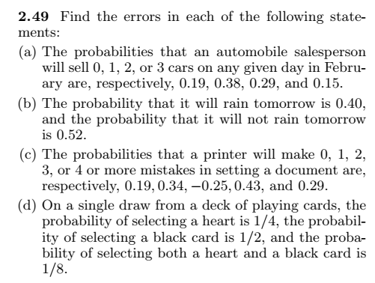
Exercises

Slide 38
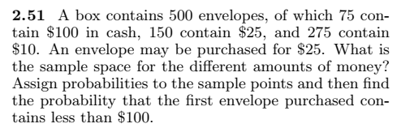
Notes:
3/10

Slide 39

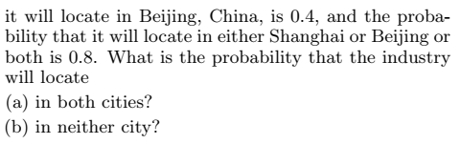
Notes:
(a) 0.3 (b) 0.2

Slide 40
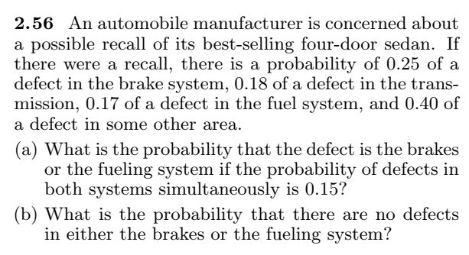
Notes:
A = Defect in brake, B = Defect in fuel, (a) P (A U B) = 0.27 (b) P (No defect ) = 0.73
P(A’ U B’) = 1 - P(A intersection B)
P(A’ intersection B’) = 1 - P (A U B)

